Slide 1
Introduction to Differential Equations - Lecture 3
Fei Qi
Email: fei.qi@du.edu
Office Hour: TBA
Website: https://feiqimath.github.io

Slide 2
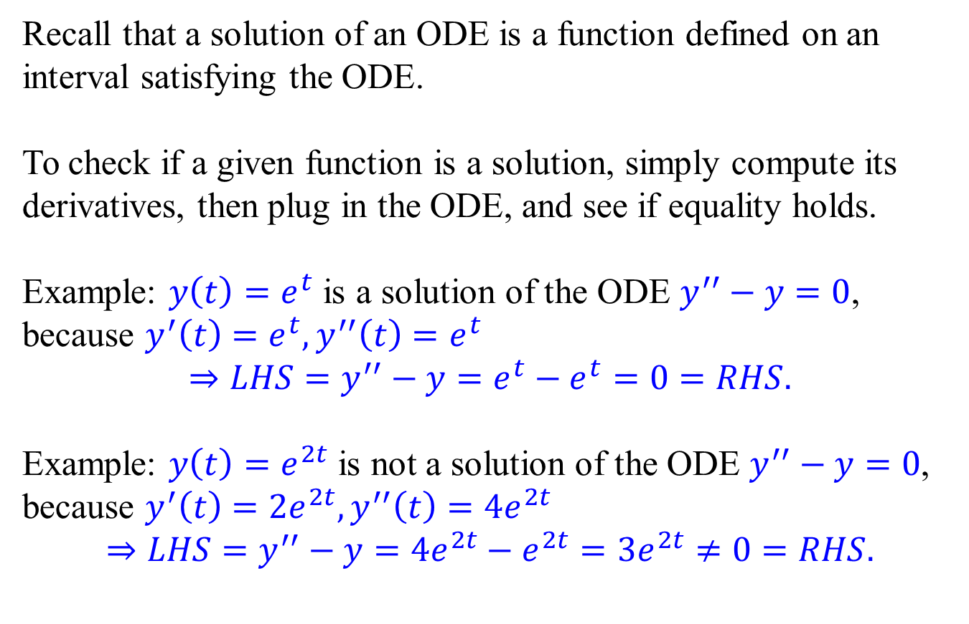
How to check if a given function is a solution
Recall that a solution of an ODE is a function defined on an interval satisfying the ODE.
To check if a given function is a solution, simply compute its derivatives, then plug in the ODE, and see if equality holds.
Example: $y\left(t\right)=e^{t}$ is a solution of the ODE $y^{′′}−y=0$,
because $y^{′}\left(t\right)=e^{t},y^{′′}\left(t\right)=e^{t}$ $$⇒LHS=y^{′′}−y=e^{t}−e^{t}=0=RHS.$$
Example: $y\left(t\right)=e^{2t}$ is not a solution of the ODE $y^{′′}−y=0$,
because $y^{′}\left(t\right)={2e}^{2t},y^{′′}\left(t\right)=4e^{2t}$ $$⇒LHS=y^{′′}−y={4e}^{2t}−e^{2t}=3e^{2t}≠0=RHS.$$

Slide 3
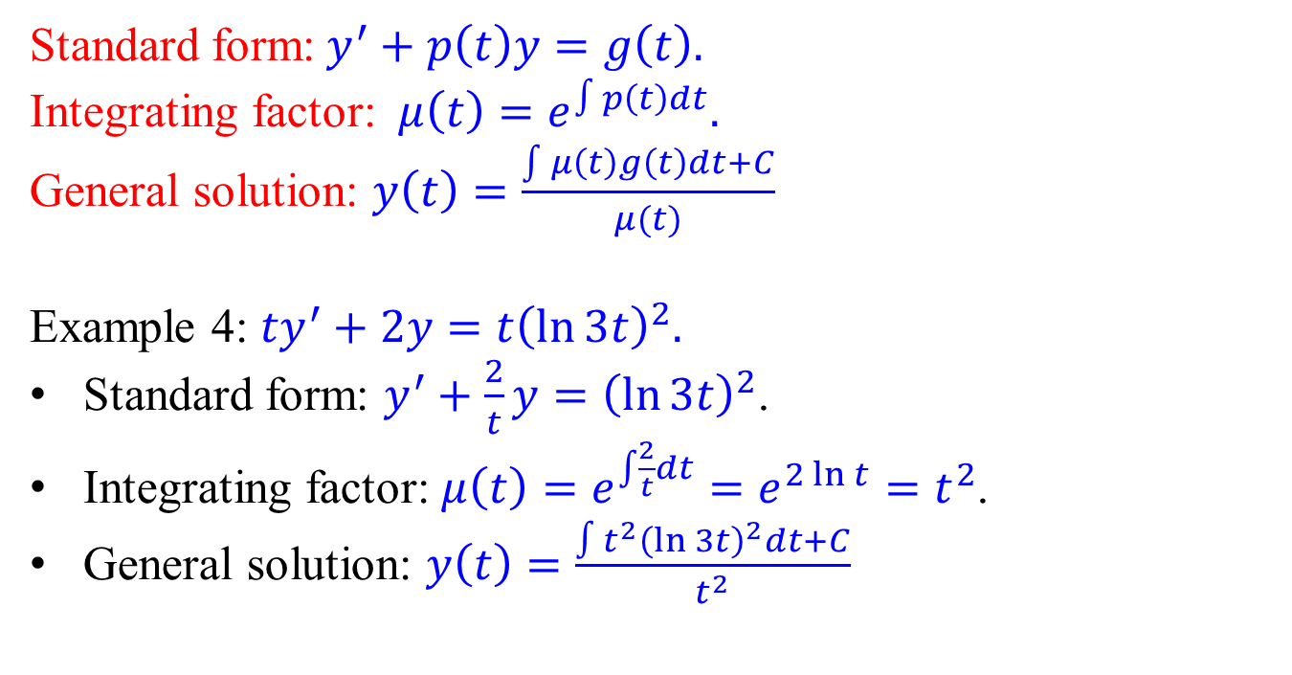
First-order linear ODEs - Example 4
Standard form:$y^{′}+p\left(t\right)y=g\left(t\right).$
Integrating factor: $μ\left(t\right)=e^{∫p\left(t\right)dt}.$
General solution: $y\left(t\right)=\frac{\int{μ\left(t\right)g\left(t\right)dt}+C}{μ(t)}$
Example 4: ${ty}^{′}+2y=t{\left(\ln{3t}\right)}^{2}.$
Standard form: $y^{′}+\frac{2}{t}y={\left(\ln{3t}\right)}^{2}$.
Integrating factor: $μ\left(t\right)=e^{\int{\frac{2}{t}}dt}=e^{2\ln{t}}=t^{2}$.
General solution: $y\left(t\right)=\frac{∫t^{2}{\left(\ln{3t}\right)}^{2}dt+C}{t^{2}}$

Slide 4
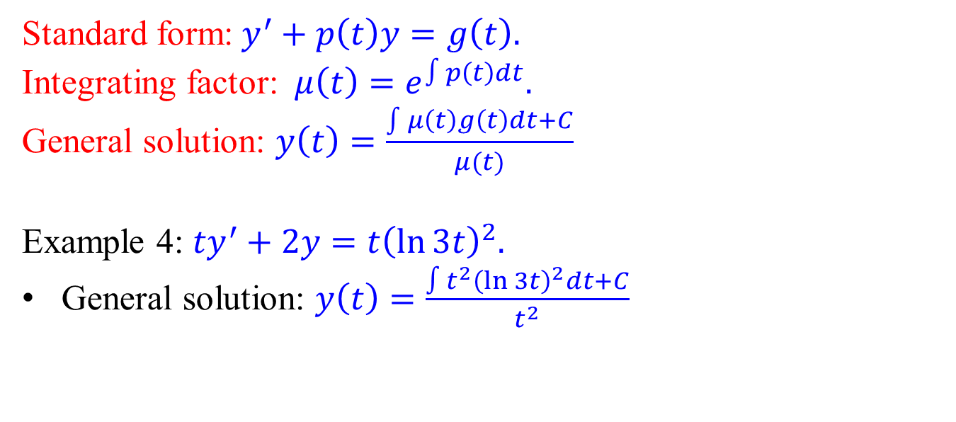
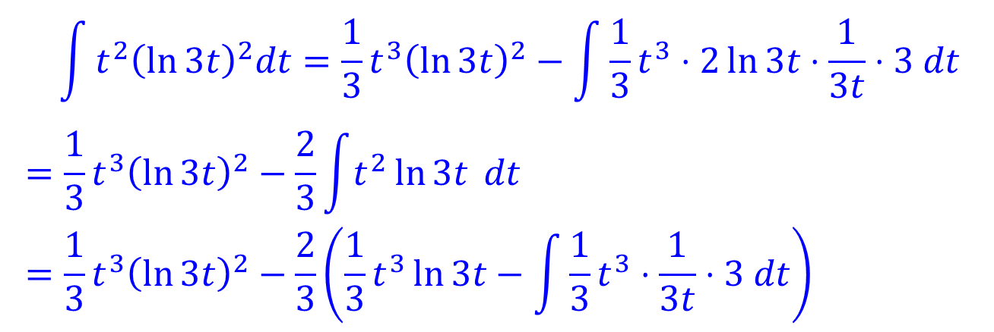
First-order linear ODEs - Example 4
Standard form:$y^{′}+p\left(t\right)y=g\left(t\right).$
Integrating factor: $μ\left(t\right)=e^{∫p\left(t\right)dt}.$
General solution: $y\left(t\right)=\frac{\int{μ\left(t\right)g\left(t\right)dt}+C}{μ(t)}$
Example 4: ${ty}^{′}+2y=t{\left(\ln{3t}\right)}^{2}.$
General solution: $y\left(t\right)=\frac{∫t^{2}{\left(\ln{3t}\right)}^{2}dt+C}{t^{2}}$
$$\int{t^{2}{\left(\ln{3t}\right)}^{2}dt}=\frac{1}{3}t^{3}{\left(\ln{3t}\right)}^{2}−\int{\frac{1}{3}t^{3}⋅2\ln{3t}⋅\frac{1}{3t}⋅3 dt} \\ =\frac{1}{3}t^{3}{\left(\ln{3t}\right)}^{2}−\frac{2}{3}\int{t^{2}\ln{3t} dt} \\ =\frac{1}{3}t^{3}{\left(\ln{3t}\right)}^{2}−\frac{2}{3}\left(\frac{1}{3}t^{3}\ln{3t}−\int{\frac{1}{3}t^{3}⋅\frac{1}{3t}⋅3 dt}\right)$$

Slide 5
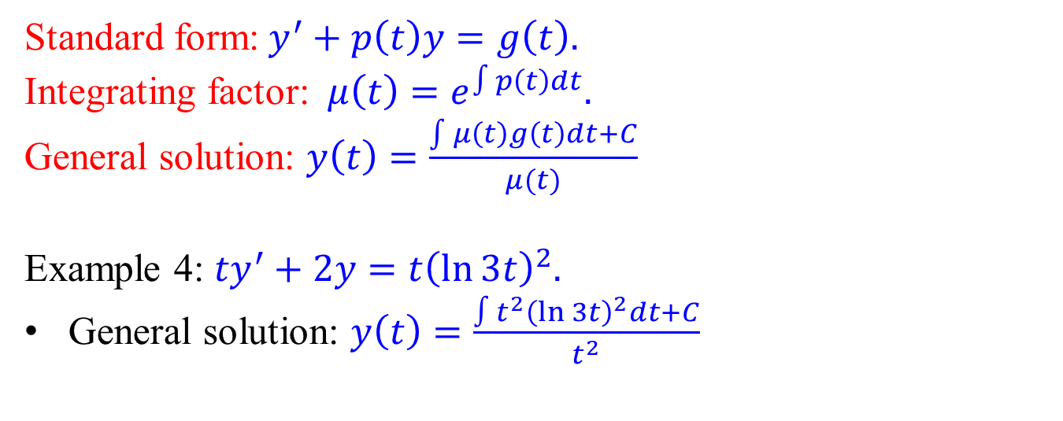
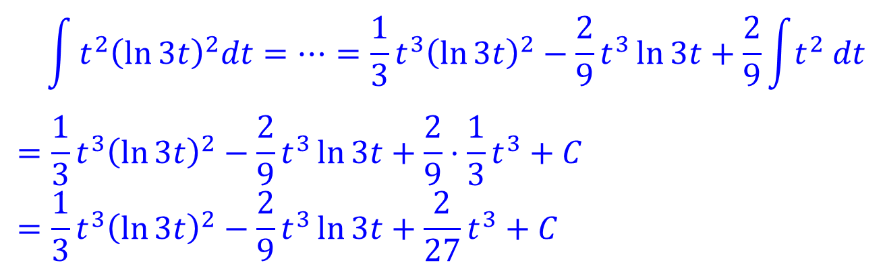
First-order linear ODEs - Example 4
Standard form:$y^{′}+p\left(t\right)y=g\left(t\right).$
Integrating factor: $μ\left(t\right)=e^{∫p\left(t\right)dt}.$
General solution: $y\left(t\right)=\frac{\int{μ\left(t\right)g\left(t\right)dt}+C}{μ(t)}$
Example 4: ${ty}^{′}+2y=t{\left(\ln{3t}\right)}^{2}.$
General solution: $y\left(t\right)=\frac{∫t^{2}{\left(\ln{3t}\right)}^{2}dt+C}{t^{2}}$
$$\int{t^{2}{\left(\ln{3t}\right)}^{2}dt}=⋯=\frac{1}{3}t^{3}{\left(\ln{3t}\right)}^{2}−\frac{2}{9}t^{3}\ln{3t}+\frac{2}{9}\int{t^{2} dt} \\ =\frac{1}{3}t^{3}{\left(\ln{3t}\right)}^{2}−\frac{2}{9}t^{3}\ln{3t}+\frac{2}{9}⋅\frac{1}{3}t^{3}+C \\ =\frac{1}{3}t^{3}{\left(\ln{3t}\right)}^{2}−\frac{2}{9}t^{3}\ln{3t}+\frac{2}{27}t^{3}+C$$

Slide 6
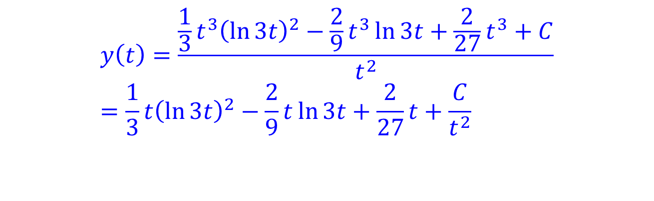
First-order linear ODEs - Example 4
Standard form:$y^{′}+p\left(t\right)y=g\left(t\right).$
Integrating factor: $μ\left(t\right)=e^{∫p\left(t\right)dt}.$
General solution: $y\left(t\right)=\frac{\int{μ\left(t\right)g\left(t\right)dt}+C}{μ(t)}$
Example 4: ${ty}^{′}+2y=t{\left(\ln{3t}\right)}^{2}.$
General solution: $y\left(t\right)=\frac{∫t^{2}{\left(\ln{3t}\right)}^{2}dt+C}{t^{2}}$
$$y\left(t\right)=\frac{\frac{1}{3}t^{3}{\left(\ln{3t}\right)}^{2}−\frac{2}{9}t^{3}\ln{3t}+\frac{2}{27}t^{3}+C}{t^{2}} \\ =\frac{1}{3}t{\left(\ln{3t}\right)}^{2}−\frac{2}{9}t\ln{3t}+\frac{2}{27}t+\frac{C}{t^{2}}$$

Slide 7
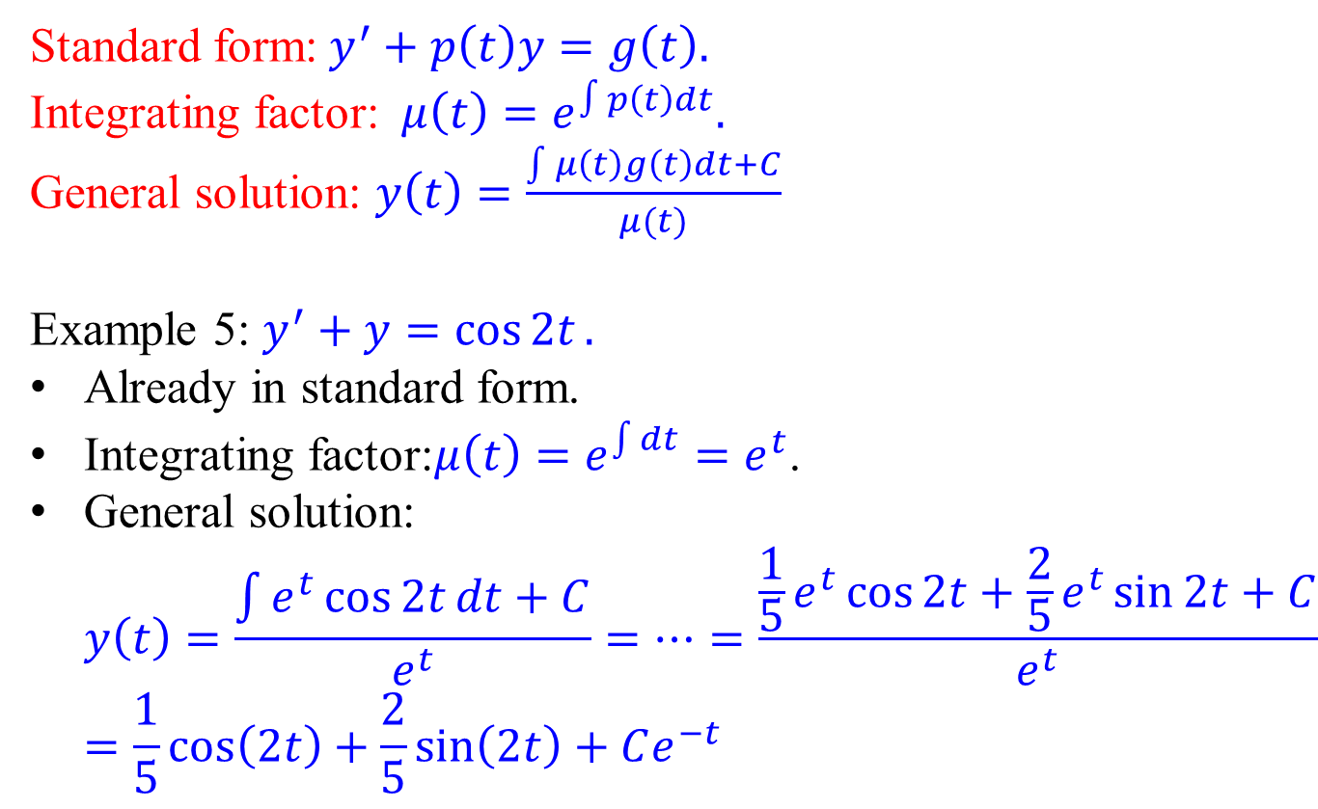
First-order linear ODEs - Example 5
Standard form:$y^{′}+p\left(t\right)y=g\left(t\right).$
Integrating factor: $μ\left(t\right)=e^{∫p\left(t\right)dt}.$
General solution: $y\left(t\right)=\frac{\int{μ\left(t\right)g\left(t\right)dt}+C}{μ(t)}$
Example 5: $y^{′}+y=\cos{2t}.$
Already in standard form.
Integrating factor:$μ\left(t\right)=e^{\int{dt}}=e^{t}$.
General solution: $y\left(t\right)=\frac{\int{e^{t}\cos{2t}dt}+C}{e^{t}}=⋯=\frac{\frac{1}{5}e^{t}\cos{2t}+\frac{2}{5}e^{t}\sin{2t}+C}{e^{t}}=\frac{1}{5}\cos\left(2t\right)+\frac{2}{5}\sin\left(2t\right)+Ce^{−t}$

Slide 8
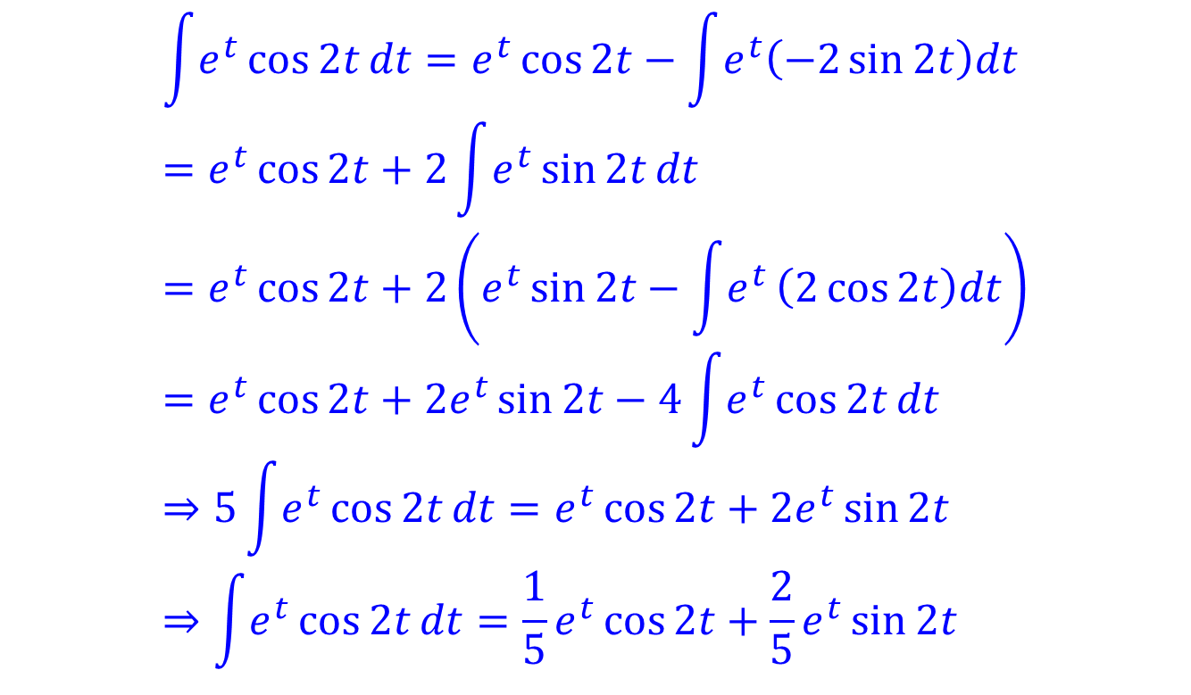
First-order linear ODEs - Example 5
$$\int{e^{t}\cos{2t}dt}=e^{t}\cos{2t}−\int{e^{t}\left(−2\sin{2t}\right)dt} \\ =e^{t}\cos{2t}+2\int{e^{t}}\sin{2t}dt \\ =e^{t}\cos{2t}+2\left(e^{t}\sin{2t}−\int{e^{t}}\left(2\cos{2t}\right)dt\right) \\ =e^{t}\cos{2t}+2e^{t}\sin{2t}−4\int{e^{t}}\cos{2t}dt \\ ⇒5\int{e^{t}\cos{2t}dt}=e^{t}\cos{2t}+2e^{t}\sin{2t} \\ ⇒\int{e^{t}\cos{2t}dt}=\frac{1}{5}e^{t}\cos{2t}+\frac{2}{5}e^{t}\sin{2t}$$

Slide 9
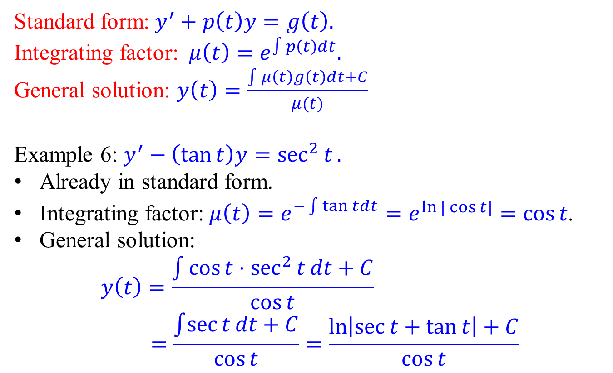
First-order linear ODEs - Example 6
Standard form:$y^{′}+p\left(t\right)y=g\left(t\right).$
Integrating factor: $μ\left(t\right)=e^{∫p\left(t\right)dt}.$
General solution: $y\left(t\right)=\frac{\int{μ\left(t\right)g\left(t\right)dt}+C}{μ(t)}$
Example 6: $y^{′}−\left(\tan{t}\right)y=\sec^{2}{t}.$
Already in standard form.
Integrating factor: $μ\left(t\right)=e^{−\int{\tan{t}}dt}=e^{\ln{|\cos{t}|}}=\cos{t}$.
General solution:
$$y\left(t\right)=\frac{\int{\cos{t}⋅\sec^{2}{t}}dt+C}{\cos{t}} \\ =\frac{\int{\sec{t}}dt+C}{\cos{t}}=\frac{\ln\left|\sec{t}+\tan{t}\right|+C}{\cos{t}}$$
Ignore the absolute value
Check the Review Slides

Slide 10
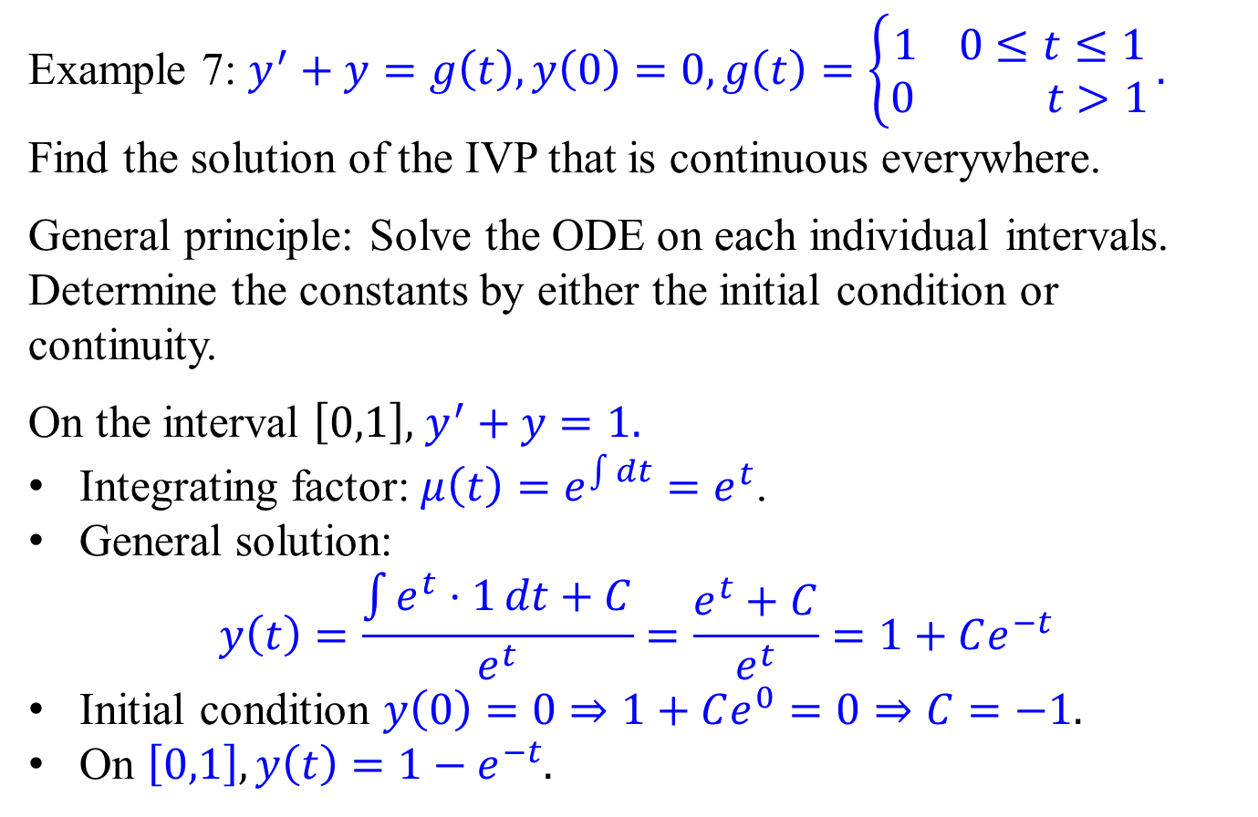
First-order linear ODEs - Example 7
Example 7: $y^{′}+y=g\left(t\right),y\left(0\right)=0,g\left(t\right)=\left\{\begin{aligned}1 0≤t≤1 \\ 0 t>1\end{aligned}\right..$
Find the solution of the IVP that is continuous everywhere.
General principle: Solve the ODE on each individual intervals. Determine the constants by either the initial condition or continuity.
On the interval $\left[0,1\right],$ $y^{′}+y=1.$
Integrating factor: $μ\left(t\right)=e^{\int{dt}}=e^{t}$.
General solution:
$$y\left(t\right)=\frac{\int{e^{t}⋅1}dt+C}{e^{t}}=\frac{e^{t}+C}{e^{t}}=1+Ce^{−t}$$
Initial condition $y\left(0\right)=0⇒1+Ce^{0}=0⇒C=−1$.
On $\left[0,1\right], y\left(t\right)=1−e^{−t}$.

Slide 11
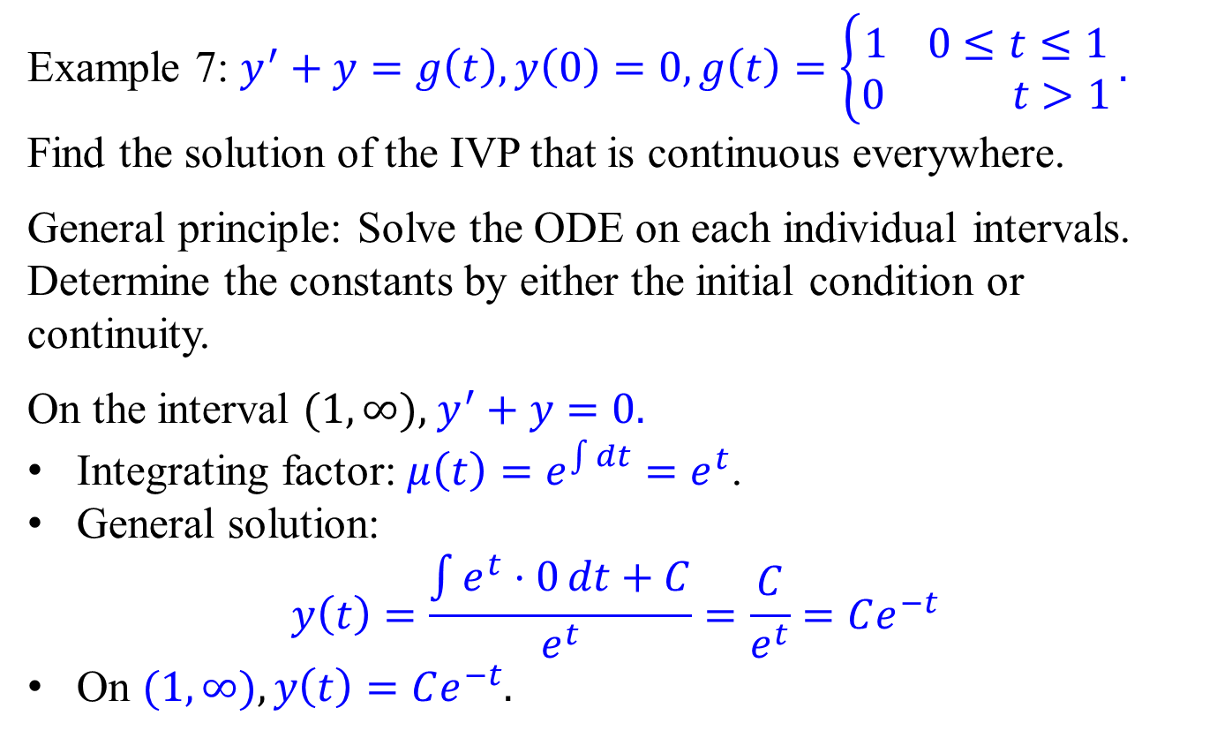
First-order linear ODEs - Example 7
Example 7: $y^{′}+y=g\left(t\right),y\left(0\right)=0,g\left(t\right)=\left\{\begin{aligned}1 0≤t≤1 \\ 0 t>1\end{aligned}\right..$
Find the solution of the IVP that is continuous everywhere.
General principle: Solve the ODE on each individual intervals. Determine the constants by either the initial condition or continuity.
On the interval $(1,∞),$ $y^{′}+y=0.$
Integrating factor: $μ\left(t\right)=e^{\int{dt}}=e^{t}$.
General solution:
$$y\left(t\right)=\frac{\int{e^{t}⋅0}dt+C}{e^{t}}=\frac{C}{e^{t}}=Ce^{−t}$$
On $(1,∞), y\left(t\right)=Ce^{−t}$.

Slide 12
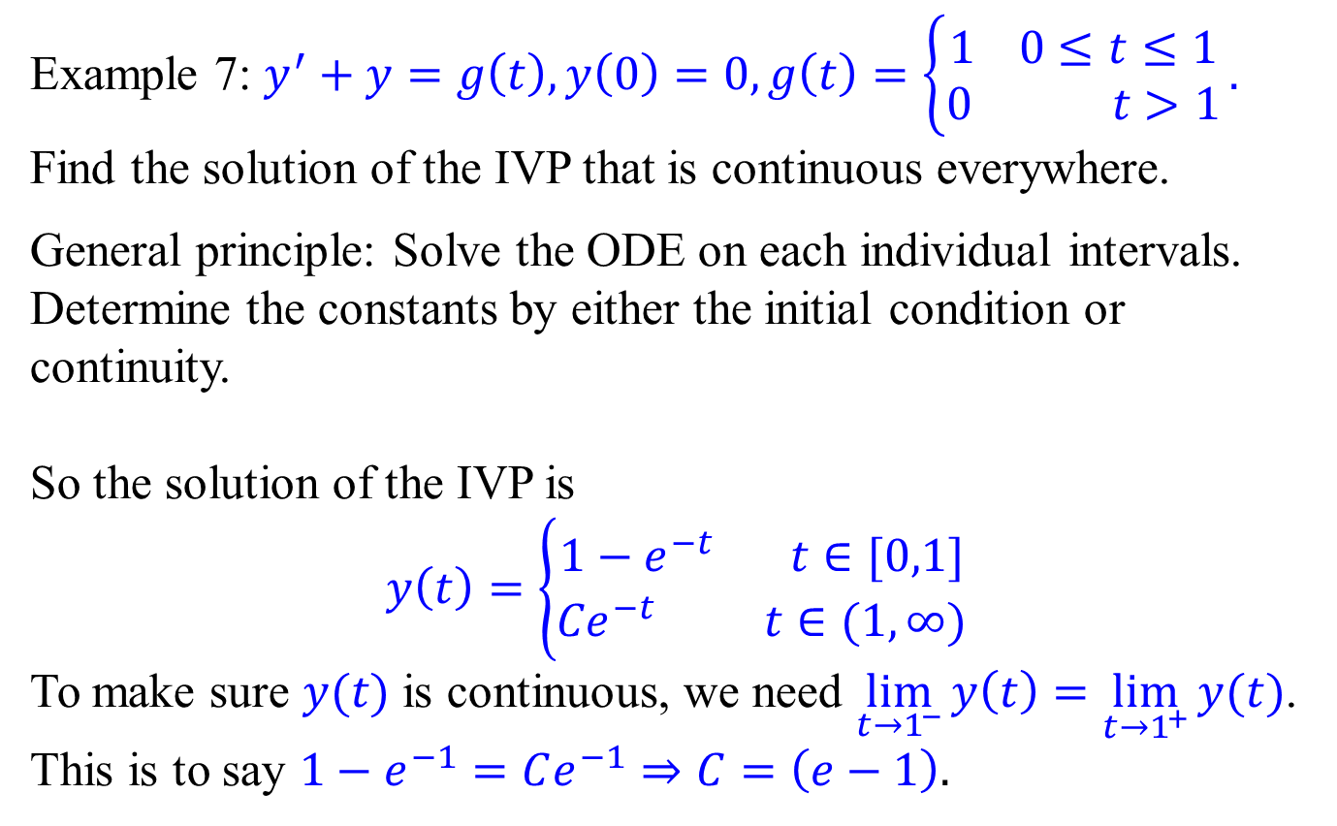
First-order linear ODEs - Example 7
Example 7: $y^{′}+y=g\left(t\right),y\left(0\right)=0,g\left(t\right)=\left\{\begin{aligned}1 0≤t≤1 \\ 0 t>1\end{aligned}\right..$
Find the solution of the IVP that is continuous everywhere.
General principle: Solve the ODE on each individual intervals. Determine the constants by either the initial condition or continuity.
So the solution of the IVP is
$$y\left(t\right)=\left\{\begin{aligned}1−e^{−t} t∈[0,1] \\ {Ce}^{−t} t∈(1,∞)\end{aligned}\right.$$
To make sure $y(t)$ is continuous, we need $\lim_{t{→1}^{−}}{y\left(t\right)}=\lim_{t{→1}^{+}}{y(t)}$.
This is to say $1−e^{−1}=Ce^{−1}⇒C=\left(e−1\right).$

Slide 13
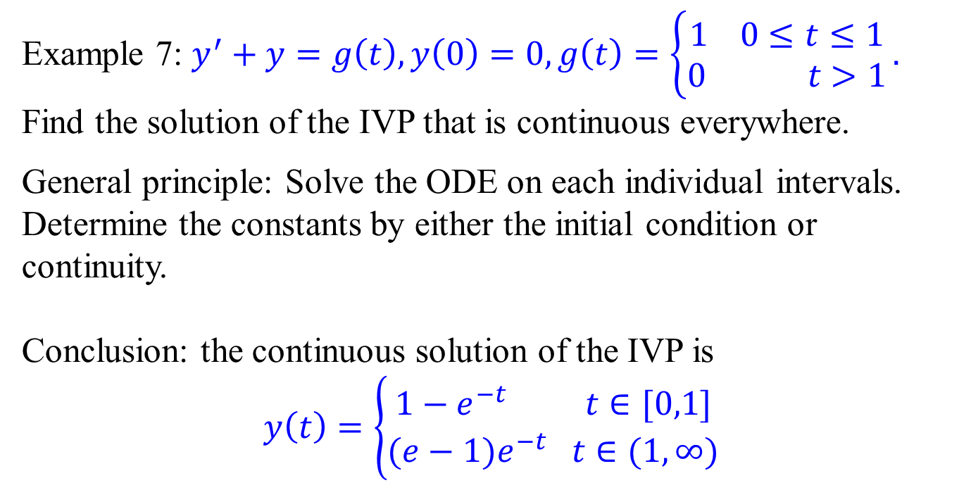
First-order linear ODEs - Example 7
Example 7: $y^{′}+y=g\left(t\right),y\left(0\right)=0,g\left(t\right)=\left\{\begin{aligned}1 0≤t≤1 \\ 0 t>1\end{aligned}\right..$
Find the solution of the IVP that is continuous everywhere.
General principle: Solve the ODE on each individual intervals. Determine the constants by either the initial condition or continuity.
Conclusion: the continuous solution of the IVP is
$$y\left(t\right)=\left\{\begin{aligned}1−e^{−t} t∈[0,1] \\ {(e−1)e}^{−t} t∈(1,∞)\end{aligned}\right.$$

Slide 14
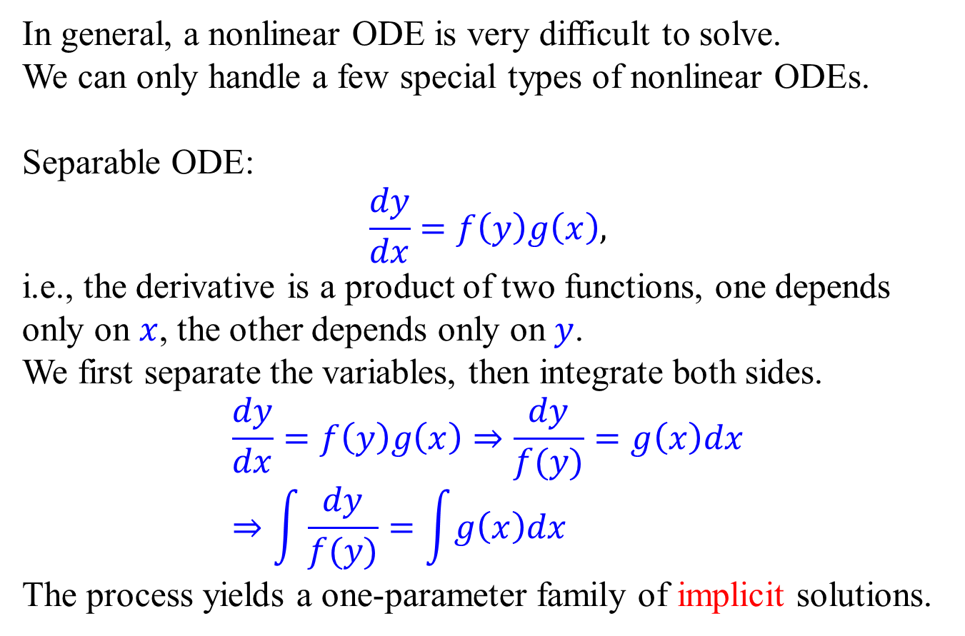
Separable ODE
In general, a nonlinear ODE is very difficult to solve.
We can only handle a few special types of nonlinear ODEs.
Separable ODE:
$$\frac{dy}{dx}=f\left(y\right)g\left(x\right),$$
i.e., the derivative is a product of two functions, one depends only on $x$, the other depends only on $y$.
We first separate the variables, then integrate both sides.
$$\frac{dy}{dx}=f\left(y\right)g\left(x\right)⇒\frac{dy}{f(y)}=g\left(x\right)dx \\ ⇒\int{\frac{dy}{f(y)}=\int{g\left(x\right)dx}}$$
The process yields a one-parameter family of implicit solutions.

Slide 15

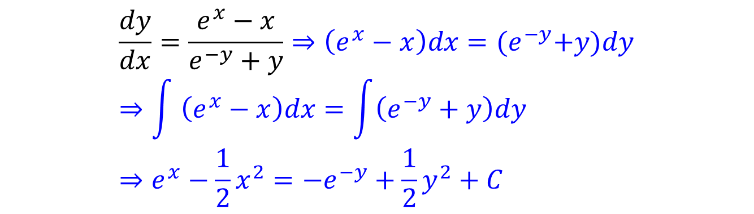
Separable ODE – Example 1
Separable ODE:
$$\frac{dy}{dx}=f\left(y\right)g\left(x\right)⇒\frac{dy}{f(y)}=g\left(x\right)dx \\ ⇒\int{\frac{dy}{f(y)}=\int{g\left(x\right)dx}}$$
The process yields a one-parameter family of implicit solutions.
Example 1:
$$\frac{dy}{dx}=\frac{e^{x}−x}{e^{−y}+y}⇒\left(e^{x}−x\right)dx={(e}^{−y}+y)dy \\ ⇒\int{ \left(e^{x}−x\right)dx}=\int{\left(e^{−y}+y\right)dy} \\ ⇒e^{x}−\frac{1}{2}x^{2}={−e}^{−y}+\frac{1}{2}y^{2}+C$$
one-parameter family of implicit solutions

Slide 16

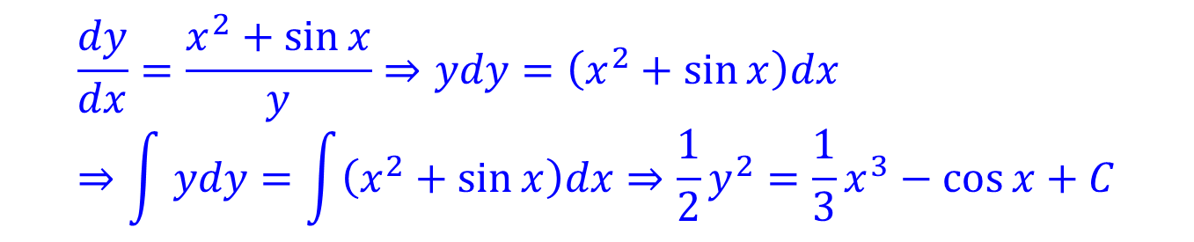
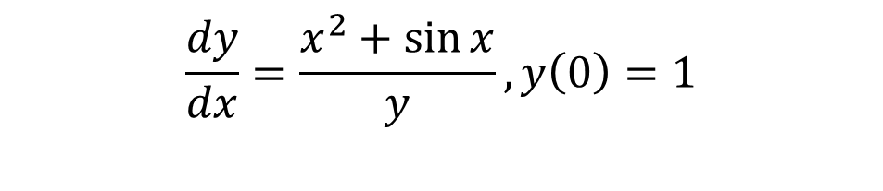
Separable ODE – Example 2
Separable ODE:
$$\frac{dy}{dx}=f\left(y\right)g\left(x\right)⇒\frac{dy}{f(y)}=g\left(x\right)dx \\ ⇒\int{\frac{dy}{f(y)}=\int{g\left(x\right)dx}}$$
The process yields a one-parameter family of implicit solutions.
Example 2:
$$\frac{dy}{dx}=\frac{x^{2}+\sin{x}}{y},y\left(0\right)=1$$
$$\frac{dy}{dx}=\frac{x^{2}+\sin{x}}{y}⇒ydy=\left(x^{2}+\sin{x}\right)dx \\ ⇒\int{ ydy}=\int{\left(x^{2}+\sin{x}\right)dx}⇒\frac{1}{2}y^{2}=\frac{1}{3}x^{3}−\cos{x+C}$$
A one-parameter family of implicit solutions

Slide 17
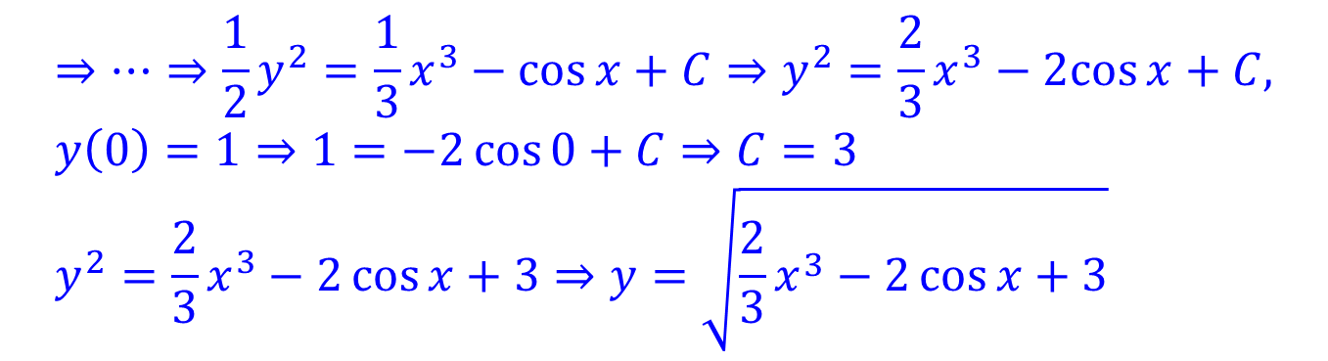
Separable ODE – Example 2
Separable ODE:
$$\frac{dy}{dx}=f\left(y\right)g\left(x\right)⇒\frac{dy}{f(y)}=g\left(x\right)dx \\ ⇒\int{\frac{dy}{f(y)}=\int{g\left(x\right)dx}}$$
The process yields a one-parameter family of implicit solutions.
Example 2:
$$\frac{dy}{dx}=\frac{x^{2}+\sin{x}}{y},y\left(0\right)=1$$
$$⇒⋯⇒\frac{1}{2}y^{2}=\frac{1}{3}x^{3}−\cos{x+C}⇒y^{2}=\frac{2}{3}x^{3}−2cos{x+C,} \\ y\left(0\right)=1⇒1=−2\cos{0+C}⇒C=3 \\ y^{2}=\frac{2}{3}x^{3}−2\cos{x}+3⇒y=\sqrt{\frac{2}{3}x^{3}−2\cos{x}+3}$$
Positive branch because y(0) > 0
An explicit solution, but the interval of existence is hard.

Slide 18
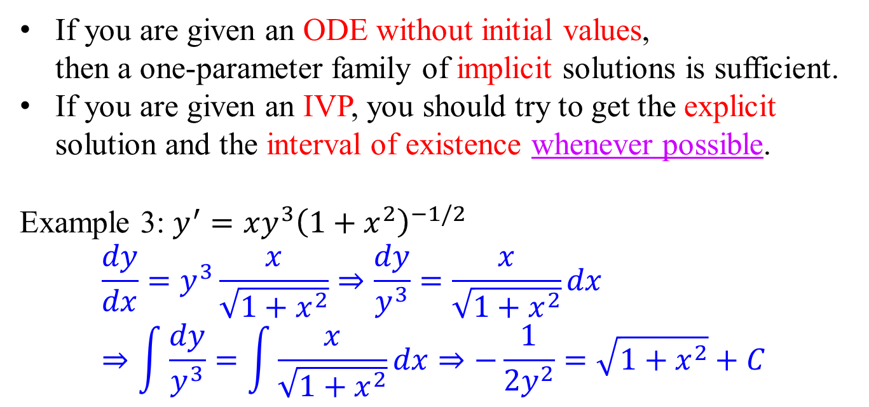
Implicit solution vs explicit solution
If you are given an ODE without initial values, then a one-parameter family of implicit solutions is sufficient.
If you are given an IVP, you should try to get the explicit solution and the interval of existence whenever possible.
Example 3: $y^{′}=xy^{3}{\left(1+x^{2}\right)}^{−1/2}$
$$\frac{dy}{dx}=y^{3}\frac{x}{\sqrt{1+x^{2}}}⇒\frac{dy}{y^{3}}=\frac{x}{\sqrt{1+x^{2}}}dx \\ ⇒\int{\frac{dy}{y^{3}}}=\int{\frac{x}{\sqrt{1+x^{2}}}dx}⇒−\frac{1}{2y^{2}}=\sqrt{1+x^{2}}+C$$
one-parameter family of implicit solutions

Slide 19
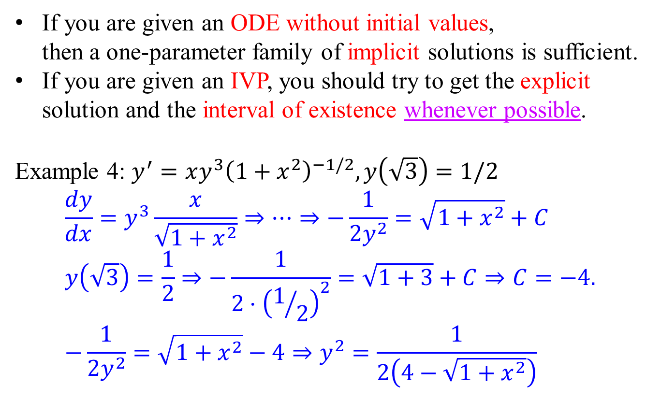
Implicit solution vs explicit solution
If you are given an ODE without initial values, then a one-parameter family of implicit solutions is sufficient.
If you are given an IVP, you should try to get the explicit solution and the interval of existence whenever possible.
Example 4: $y^{′}=xy^{3}{\left(1+x^{2}\right)}^{−1/2}, y\left(\sqrt{3}\right)=1/2$
$$\frac{dy}{dx}=y^{3}\frac{x}{\sqrt{1+x^{2}}}⇒⋯⇒−\frac{1}{2y^{2}}=\sqrt{1+x^{2}}+C \\ y\left(\sqrt{3}\right)=\frac{1}{2}⇒−\frac{1}{2⋅{\left(1/2\right)}^{2}}=\sqrt{1+3}+C⇒C=−4. \\ −\frac{1}{2y^{2}}=\sqrt{1+x^{2}}−4⇒y^{2}=\frac{1}{2\left(4−\sqrt{1+x^{2}}\right)}$$

Slide 20
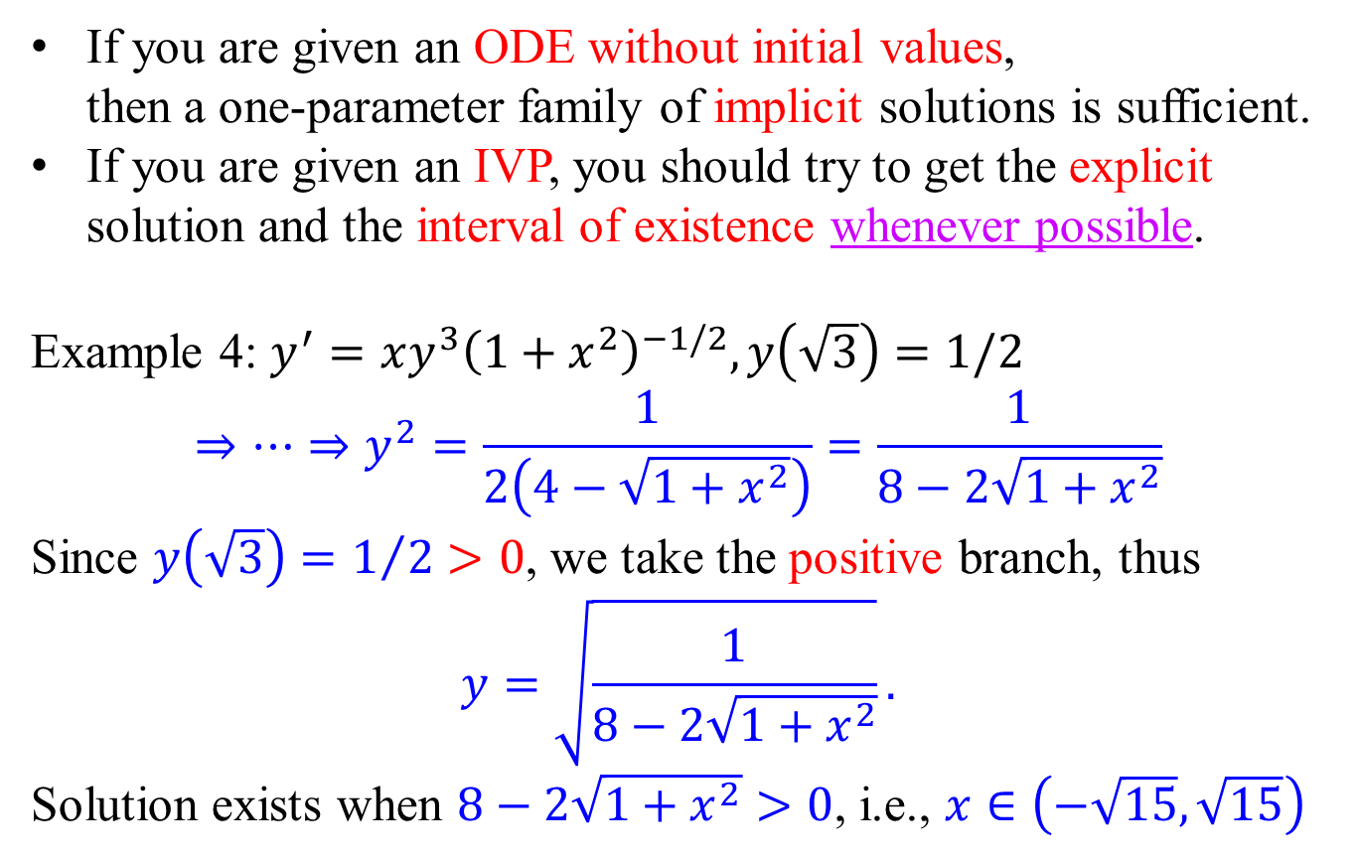
Implicit solution vs explicit solution
If you are given an ODE without initial values, then a one-parameter family of implicit solutions is sufficient.
If you are given an IVP, you should try to get the explicit solution and the interval of existence whenever possible.
Example 4: $y^{′}=xy^{3}{\left(1+x^{2}\right)}^{−1/2}, y\left(\sqrt{3}\right)=1/2$
$$⇒⋯⇒y^{2}=\frac{1}{2\left(4−\sqrt{1+x^{2}}\right)}=\frac{1}{8−2\sqrt{1+x^{2}}}$$
Since $y\left(\sqrt{3}\right)=1/2>0$, we take the positive branch, thus
$$y=\sqrt{\frac{1}{8−2\sqrt{1+x^{2}}}}.$$
Solution exists when $8−2\sqrt{1+x^{2}}>0$, i.e., $x∈\left(−\sqrt{15},\sqrt{15}\right)$

Slide 21
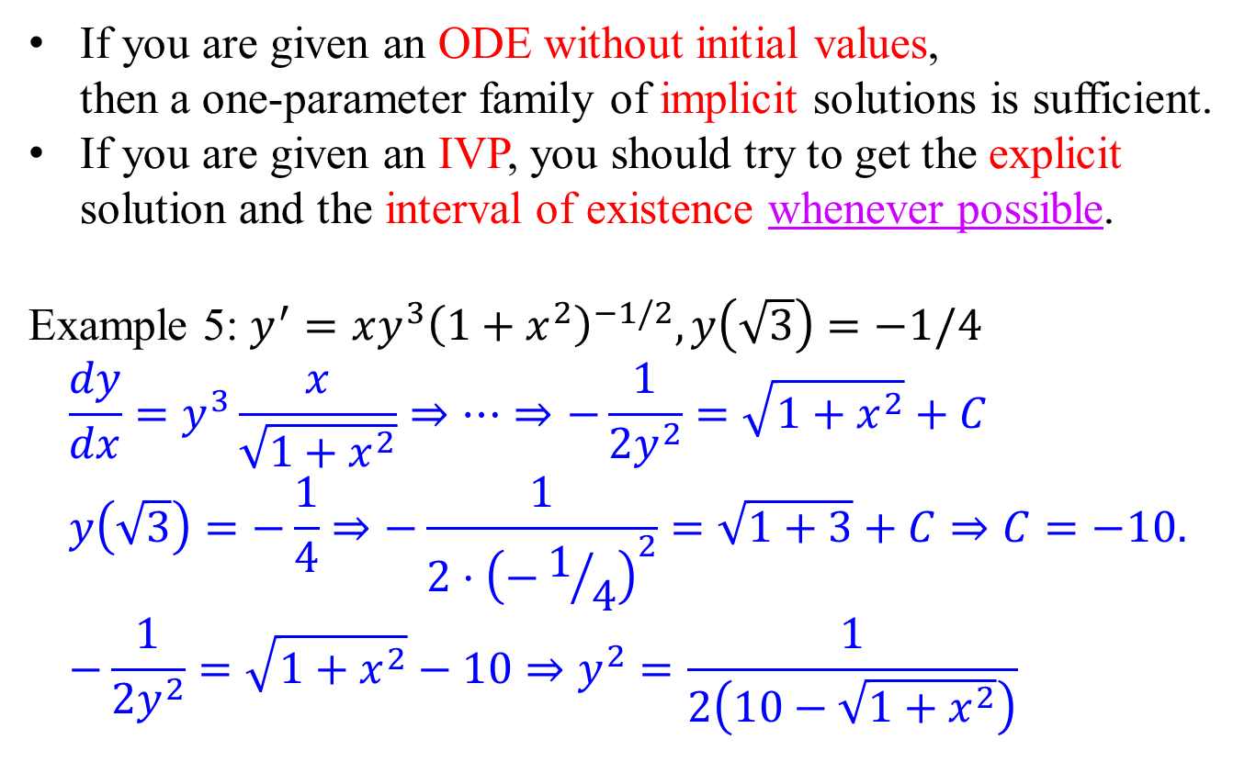
Implicit solution vs explicit solution
If you are given an ODE without initial values, then a one-parameter family of implicit solutions is sufficient.
If you are given an IVP, you should try to get the explicit solution and the interval of existence whenever possible.
Example 5: $y^{′}=xy^{3}{\left(1+x^{2}\right)}^{−1/2}, y\left(\sqrt{3}\right)=−1/4$
$$\frac{dy}{dx}=y^{3}\frac{x}{\sqrt{1+x^{2}}}⇒⋯⇒−\frac{1}{2y^{2}}=\sqrt{1+x^{2}}+C \\ y\left(\sqrt{3}\right)=−\frac{1}{4}⇒−\frac{1}{2⋅{\left(−1/4\right)}^{2}}=\sqrt{1+3}+C⇒C=−10. \\ −\frac{1}{2y^{2}}=\sqrt{1+x^{2}}−10⇒y^{2}=\frac{1}{2\left(10−\sqrt{1+x^{2}}\right)}$$

Slide 22
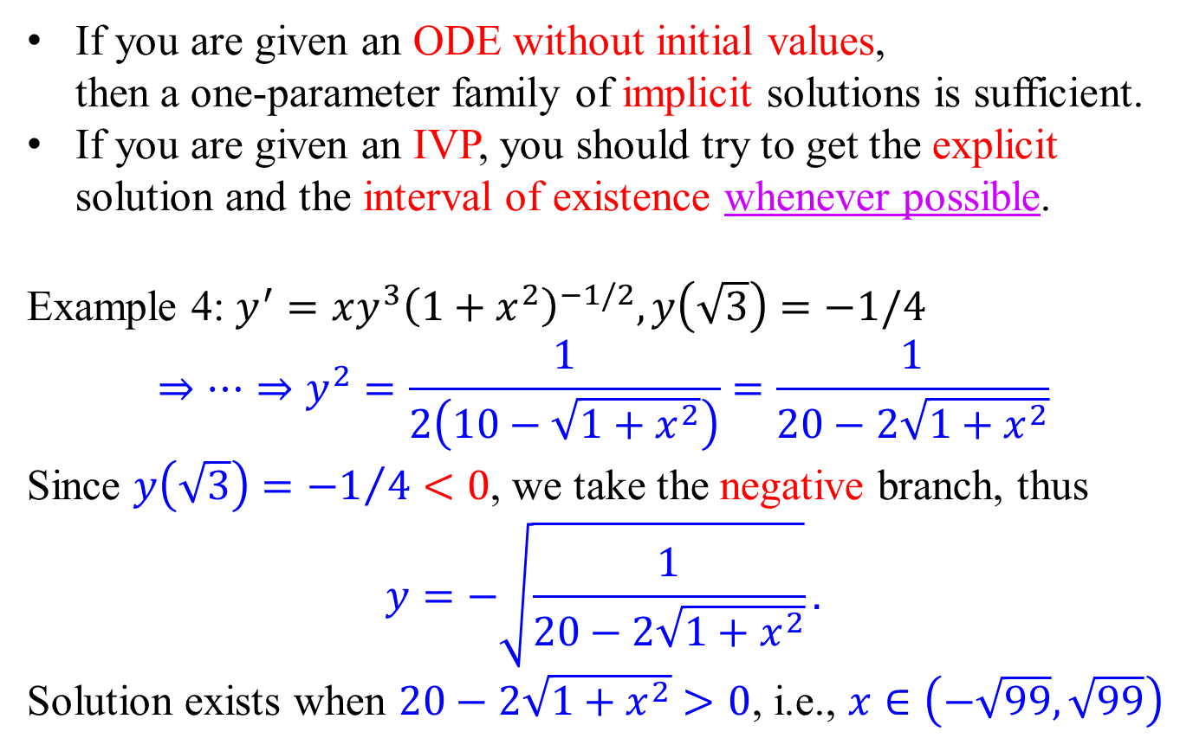
Implicit solution vs explicit solution
If you are given an ODE without initial values, then a one-parameter family of implicit solutions is sufficient.
If you are given an IVP, you should try to get the explicit solution and the interval of existence whenever possible.
Example 4: $y^{′}=xy^{3}{\left(1+x^{2}\right)}^{−1/2}, y\left(\sqrt{3}\right)=−1/4$
$$⇒⋯⇒y^{2}=\frac{1}{2\left(10−\sqrt{1+x^{2}}\right)}=\frac{1}{20−2\sqrt{1+x^{2}}}$$
Since $y\left(\sqrt{3}\right)={−1}/4<0$, we take the negative branch, thus
$$y=−\sqrt{\frac{1}{20−2\sqrt{1+x^{2}}}}.$$
Solution exists when $20−2\sqrt{1+x^{2}}>0$, i.e., $x∈\left(−\sqrt{99},\sqrt{99}\right)$

Slide 23
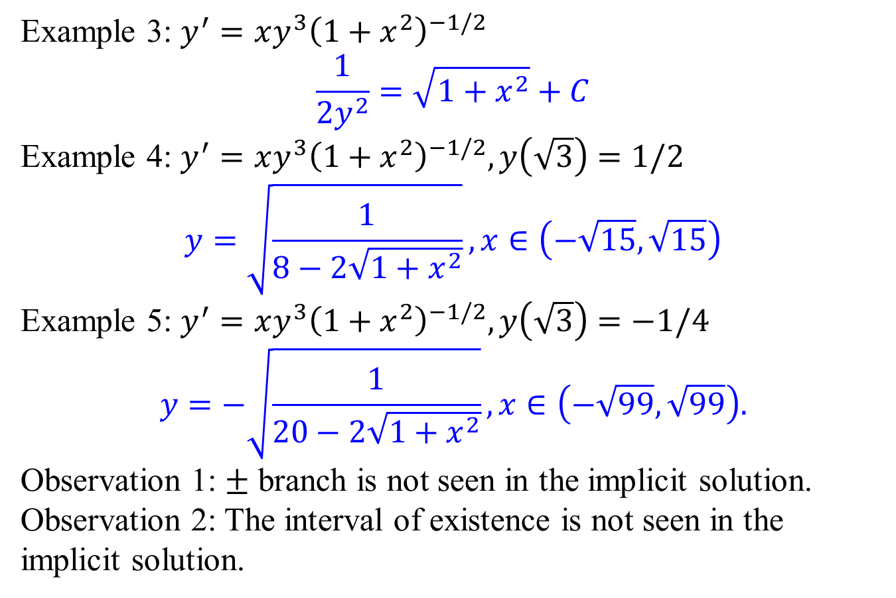
Implicit solution vs explicit solution
Example 3: $y^{′}=xy^{3}{\left(1+x^{2}\right)}^{−1/2}$
$$\frac{1}{2y^{2}}=\sqrt{1+x^{2}}+C$$
Example 4: $y^{′}=xy^{3}{\left(1+x^{2}\right)}^{−1/2}, y\left(\sqrt{3}\right)=1/2$
$$y=\sqrt{\frac{1}{8−2\sqrt{1+x^{2}}}},x∈\left(−\sqrt{15},\sqrt{15}\right)$$
Example 5: $y^{′}=xy^{3}{\left(1+x^{2}\right)}^{−1/2}, y\left(\sqrt{3}\right)=−1/4$
$$y=−\sqrt{\frac{1}{20−2\sqrt{1+x^{2}}}}, x∈\left(−\sqrt{99},\sqrt{99}\right).$$
Observation 1: $±$ branch is not seen in the implicit solution.
Observation 2: The interval of existence is not seen in the implicit solution.

Slide 24
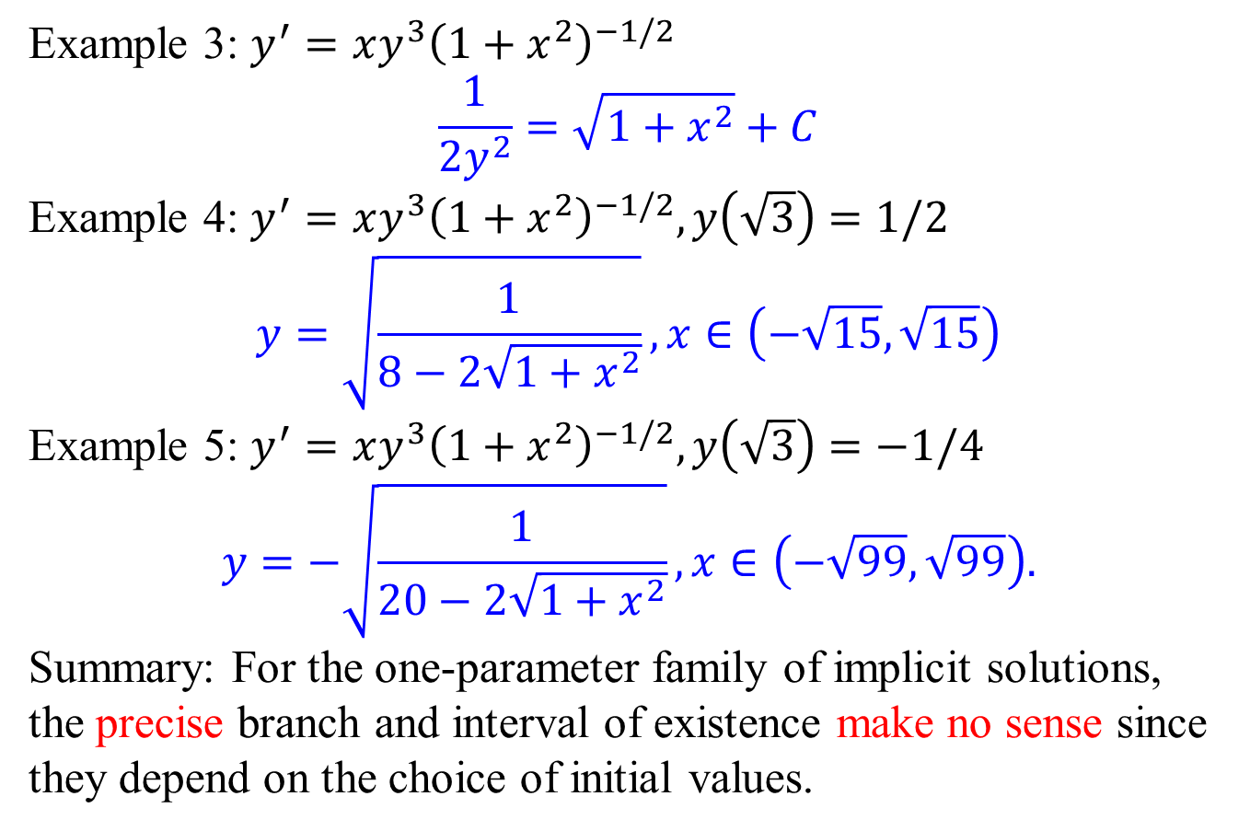
Implicit solution vs explicit solution
Example 3: $y^{′}=xy^{3}{\left(1+x^{2}\right)}^{−1/2}$
$$\frac{1}{2y^{2}}=\sqrt{1+x^{2}}+C$$
Example 4: $y^{′}=xy^{3}{\left(1+x^{2}\right)}^{−1/2}, y\left(\sqrt{3}\right)=1/2$
$$y=\sqrt{\frac{1}{8−2\sqrt{1+x^{2}}}},x∈\left(−\sqrt{15},\sqrt{15}\right)$$
Example 5: $y^{′}=xy^{3}{\left(1+x^{2}\right)}^{−1/2}, y\left(\sqrt{3}\right)=−1/4$
$$y=−\sqrt{\frac{1}{20−2\sqrt{1+x^{2}}}}, x∈\left(−\sqrt{99},\sqrt{99}\right).$$
Summary: For the one-parameter family of implicit solutions, the precise branch and interval of existence make no sense since they depend on the choice of initial values.

